Slide 1

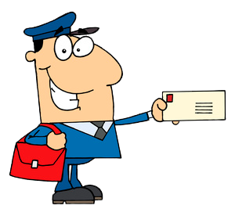
API TESTING WITH POSTMAN

Slide 2

API SCHEMA VALIDATION

Slide 3

WHAT IS JSON SCHEMA ?
JSON Schema is an IETF standard providing a format for what JSON data is required for a given application and how to interact with it.

Slide 4
JSON format :
[ { "id": 2, "name": "An ice sculpture", "price": 12.50, }, { "id": 3, "name": "A blue mouse", "price": 25.50, } ]
JSON Schema :
{ "$schema": "http://json-schema.org/draft-04/schema#", "title": "Product", "description": "A product from Acme's catalog", "type": "object", "properties": { "id": { "description": "The unique identifier for a product", "type": "integer" }, "name": { "description": "Name of the product", "type": "string" }, "price": { "type": "number", "minimum": 0, "exclusiveMinimum": true } }, "required": ["id", "name", "price"] }

Slide 5
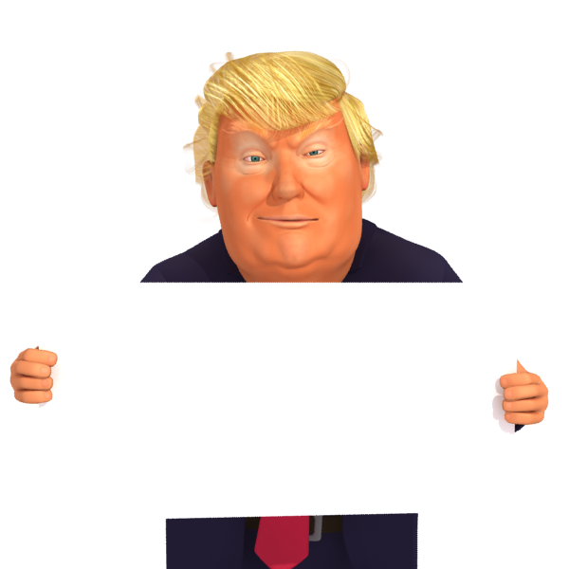
IN JSON SCHEMA :
KEYWORDS
$schema: States that this schema complies with v4 of the IETF standard
ID
Title
Description
Type
Properties
Minimum
Required
Exclusive minimum

Slide 6
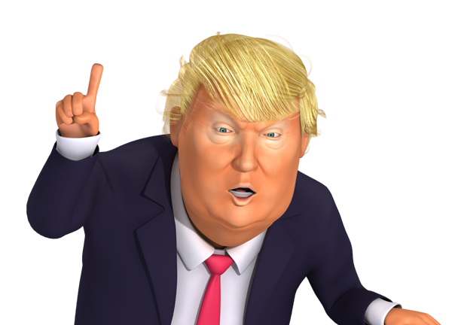
How to create JSON schema?
We can use online JSON schema generators if you have a simple JSON document, then modify the schema as per the requirement of your project.

Slide 7

Why is JSON Schema Validation required?
To monitor API responses and ensure that the format that we are getting is same as the expected one. We get alert whenever there is any breaking change in JSON response.

Slide 8
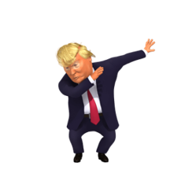
Postman Schema validator :
Tv4
tv4.validate(data, schema)

Slide 9



